Slide 1





SHADOWGRAM
In-Flight Behavioral Hypergraph Forensics & Autonomous AI Swarm Defense
TEAM: CRAFTY CREW
Jyothi Engineering College (Autonomous), Cheruthuruthy, Thrissur, Kerala
TRACK 04: SYNTHETIC IDENTITY & KYC FRAUD
Aiswarya Kallayil Rajesh (AI & DS) — Frontend & 3D WebGL Lead | Alan E Alexander (AI & DS) — Swarm Runner & Telemetry Lead
Mohammed Nihad PC (Cyber Security) — Forensics & Graph Engine Lead | Ashlin Theres James (AI & DS) — Compliance & Legal SAR Lead

Slide 2
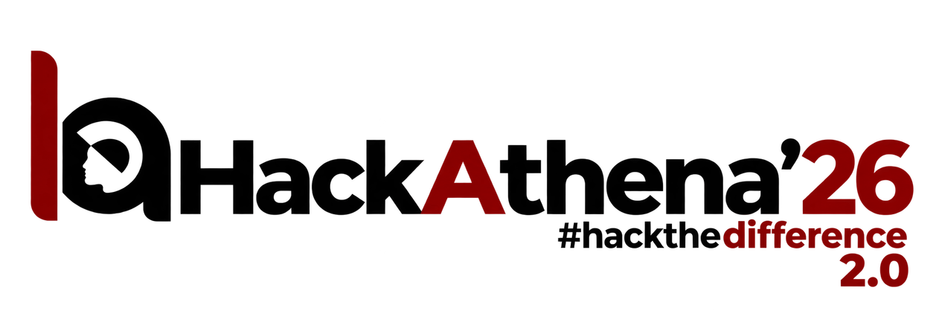
PROBLEM STATEMENT: AI SWARM CRISIS
01. CO-ORDINATED AI SWARMS
• Automated Bot Swarms: Attackers use AI bots to apply for hundreds of loans at once.
• Fake Unique Profiles: AI generates different names, bios, and loan reasons for every bot.
• +211% Surge in Fraud: Massive rise in automated attacks on instant micro-lending and BNPL apps.
• Flash Defaults: Bots take ₹5,000–₹25,000 instant loans and disappear before the first EMI.
02. WHY LEGACY DEFENSES FAIL
• Behavioral Tools (BioCatch,Sift): Needs old user history; blind to brand-new fake accounts.
• Device & IP Trackers: Easily bypassed using rotating 4G/5G mobile proxies.
• CAPTCHA Solvers: Modern Vision-AI solves visual puzzles with >70% accuracy.
• The Big Blindspot: Current tools check one account at a time, completely missing the swarm.
03. PRE-KYC COST BLEED
• Verification Cost per Bot:
• Aadhaar e-KYC API: ₹3.00 (UIDAI fee)
• PAN Verification: ₹2.00 per check
• Video Face Liveness: ₹6.00
• Credit Bureau Pull: ₹50.00
• Total Lost per Bot: ₹61.00 wasted on fake applicants before any loan decision!
• Attack Impact: 10,000 bots bleed ₹6,10,000 in non-refundable KYC fees.
★ Core Goal: Stop fake bots before paying for expensive KYC verification!

Slide 3
PROPOSED SOLUTION: TWO-KEY HYPERGRAPH DEFENSE
THE TWO-KEY ARCHITECTURE
• Key 1 (<0.02ms Fast Filter): Catches simple bots on Step 1 (no mouse movement, instant script clicks).
• Key 2 (Hypergraph Engine): Catches smart bots by checking relationships between all active users.
• Group Detection: Groups coordinated bots together into clusters using graph modularity (Q = 0.81).
• Zero Cloud Delay: Runs 100% locally on the bank server in real time.
5-LAYER INTERACTION PHYSICS
• Layer 1 (Timing): Spots bots submitting forms in synchronized bursts.
• Layer 2 (Navigation): Spots identical form-fill sequences and click paths.
• Layer 3 (Loan Reason): Semantic text vectors find similar story patterns.
• Layer 4 (Mouse Motion): Human hand tremor (8–12 Hz) vs smooth bot curves.
• Layer 5 (Hardware): WebGL & Canvas browser fingerprints.
★ 3-Layer Rule: Connects accounts only if 3+ independent layers match!
ETHICAL & REVERSIBLE RAILS
• ₹1 UPI Step-Up: Trapped users can clear their account in <10s via a ₹1 UPI check.
• Why Bots Fail UPI: Headless bots cannot bypass SIM-binding or secret MPINs at scale.
• Capital Saved: Saves ₹61.00 per bot by locking out fake KYC lookups.

Slide 4
TECHNOLOGY STACK: 4-STATION ECOSYSTEM
STATION 2: GATEWAY & GRAPH
• FastAPI & Uvicorn: High-speed event ingestion on 0.0.0.0:8000 with WebSockets.
• NetworkX & NumPy: Multi-layer graph math and community clustering algorithms.
• SQLite & SQLAlchemy: Fast, thread-safe database for sessions and telemetry.
• Local CPU Vectors: 384-dimensional text embeddings running offline in <0.2ms.
STATION 3: ZERO-PII TELEMETRY
• Zero-PII SDK: Tracks mouse and typing timing; never records text or passwords.
• Typing Dynamics: Measures millisecond timing between key presses.
• Honey-DOM Trap: Hidden button that only automated bots click.
• HMAC-SHA256: Cryptographic packet signing stops fake cURL requests.
STATIONS 1 & 3: 3D COCKPIT & SWARMS
• Three.js 3D Cockpit: Interactive 60 FPS graph visualizer with 1-click quarantine.
• Playwright Swarm: Launches 20 synchronized bots testing the system (<600MB RAM).
• Realistic Mouse Curves: Simulates natural mouse movement physics.
• NVIDIA NIM API: Fast persona generation for test attacks.
STATION 4: COURTROOM SAR & COMPLIANCE
• ReportLab PDF: Instant 2-page bank-grade legal report generated in <20ms.
• Statistical Proof: 500 graph permutations prove bots are coordinated (p = 0.0002).
• HMAC Digital Seal: Cryptographic signature for courtroom admissibility.
• Banking Compliance: Aligns with RBI Digital Lending & ECOA fair lending guidelines.

Slide 5
PROTOTYPE DEMO & CYBER RANGE BENCHMARKS
4-STATION CYBER RANGE
• Station 1 (Alan @ 10.215.30.174): Playwright swarm launches 20 stealth bots in 1.4s.
• Station 2 (Pete @ 10.215.30.162): Central Fedora gateway running live graph clustering.
• Station 3 (Aiswarya @ 10.215.30.204): Borrower portal with live ₹1 UPI verification popup.
• Station 4 ( Ashlin): Generates bank-grade 2-page courtroom PDF reports.
TEST RESULTS (120 SESSIONS)
• 100% Precision: Zero real users wrongly blocked.
• 100% Recall: Caught all 20/20 stealth bots (vs 0% caught by traditional tools).
• Math Proof: Graph Modularity Q = 0.8118 (p = 0.0002, 99.98% confidence).
• Real Savings: Saved ₹2,440 across 40 blocked test attacks.
5-ACT LIVE DEMO SCRIPT
• Act 1 (Real User): Aiswarya applies naturally -> Key 1 & 2 clear -> Instant approval.
• Act 2 (Bot Swarm): Alan triggers 20 bots -> 3D cockpit collapses them into a red cluster.
• Act 3 (1-Click Block): Pete clicks quarantine -> All 20 bots locked down instantly.
• Act 4 (UPI Recovery): Blocked user applies -> ₹1 UPI popup appears -> Cleared in <10s!
• Act 5 (Legal Report): Download 2-page courtroom-ready PDF report with HMAC seal.

